Slide 1

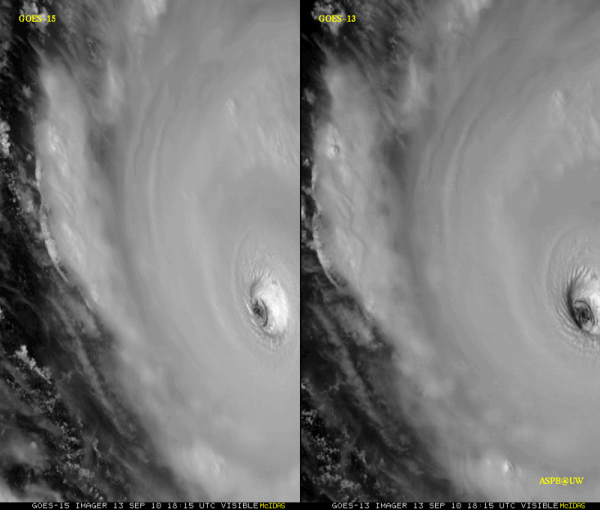
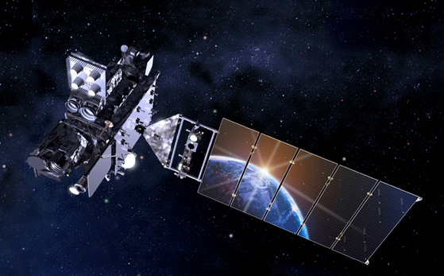
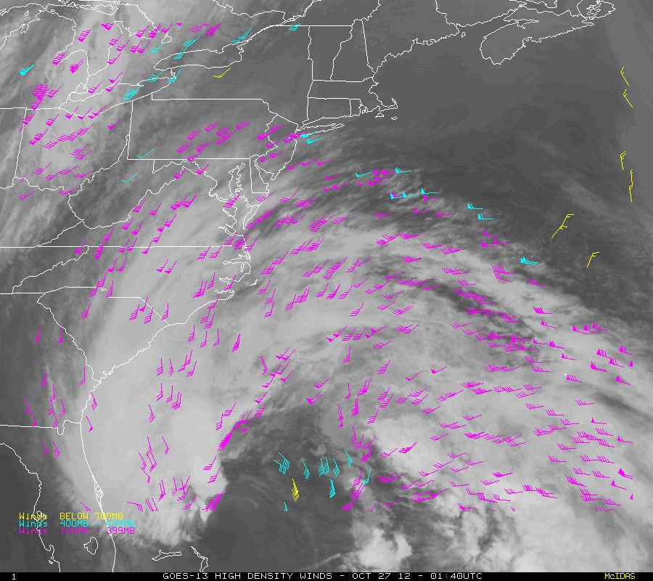
Igor Sept 2010
Sandy Oct 2012
S. J. Goodman, S. Kalluri, and R. Iacovazzi
NOAA/NESDIS-GOES-R Program

